Slide 1
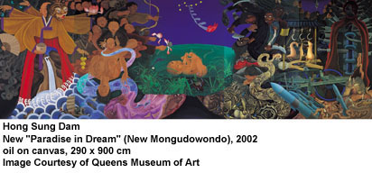
The Korean Democratic Movement and the BuMa Uprising
George Katsiaficas

Slide 2
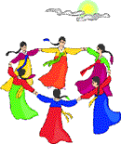
A Brief History of South Korean Uprisings Since World War 2
April 19, 1960
BuMa Uprising, October 1979
Gwangju May 18, 1980
June Uprising, 1987
Big Labor Struggle, 1987
Candlelight Protests 2008

Slide 3
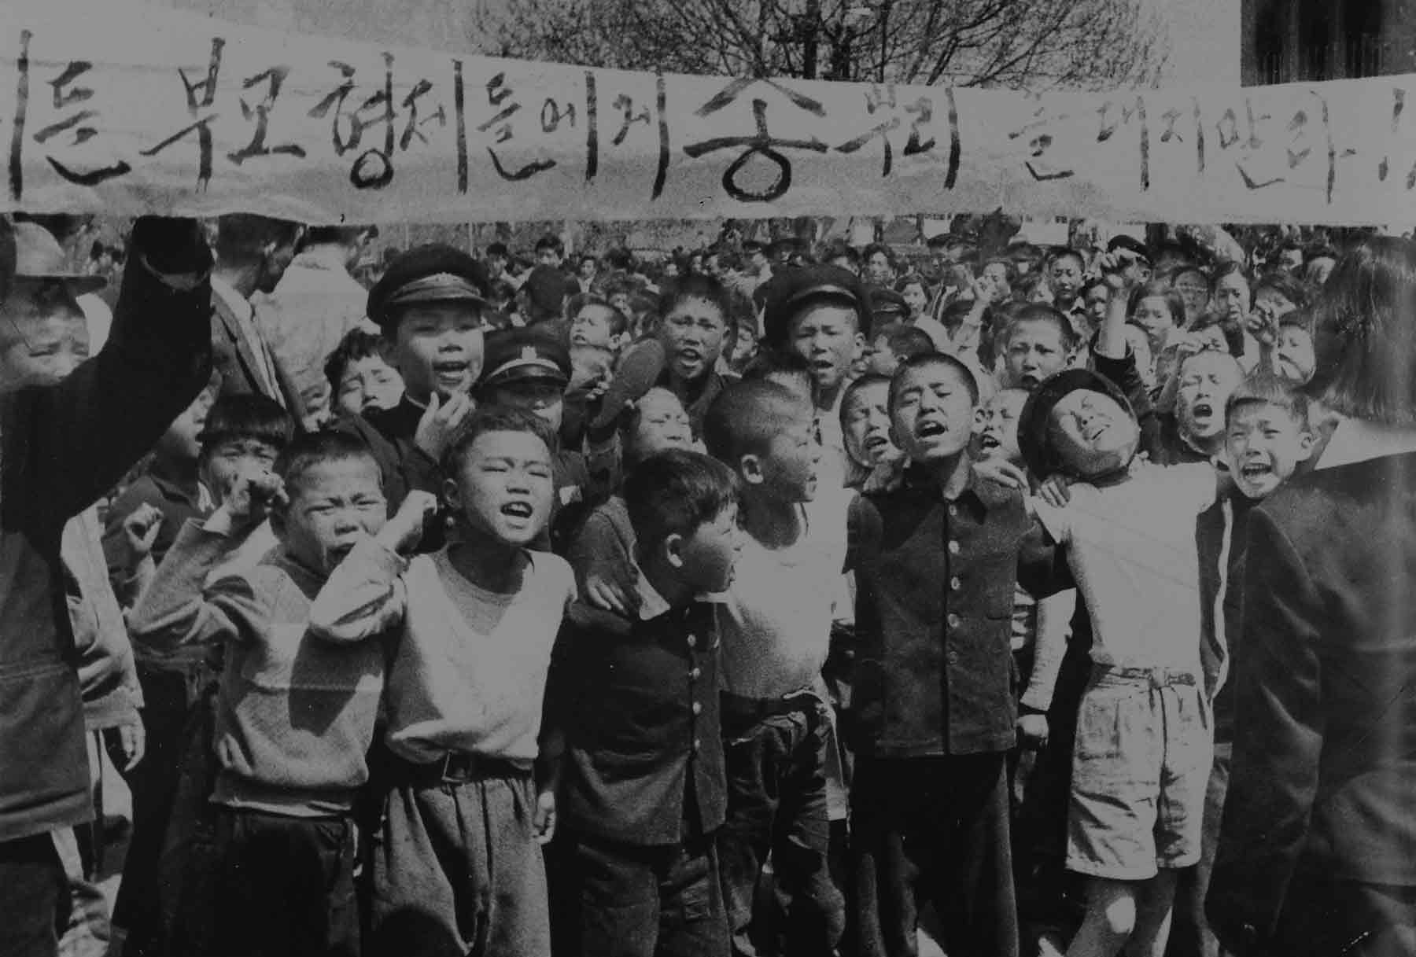
April 19, 1960
Students led protests to oust corrupt Dictator Syngman Rhee, whose police killed hundreds of youth before Rhee fled the country.

Slide 4
In Taegu on February 28, high schools students went into the streets to warn of Rhee’s plot to extend his rule.
In elections on March 15, 1960, Rhee and his cronies shamelessly stuffed ballot boxes; Rhee won more than 90%.
As soon as the election results were announced that evening, 10,000 students led a huge march in Masan on city hall to demand fresh elections.
Police immediately attacked, killing many students.
Rhee called the protests “Communist inspired.”
US commanding general Carter Magruder approved Rhee’s request to send in elite Korean marines to quiet the citizenry. Undeterred by the army, similar outbursts occurred in Pohang, Taejon, Suwon, Osan, and Chunju.
Organized groups of professors, journalists, and lawyers made public statements in support of protesting students.

Slide 5
On April 11, a fisherman discovered the bloated body of 16-year-old Kim Ju-yol’s in the sea near Masan. The young teenager from Namwon, a freshman at a Masan commercial high school, had been hit in the eye by a tear gas canister.
Police claimed he was a communist, a charge “proven” by papers linking him to North Korea found in his pockets (which many people believed had been planted).
Both the murder and the cover-up detonated the coming explosion.
Immediately, 40,000 protesters marched. Once again police killed many demonstrators, and Magruder again authorized the use of troops.

Slide 6
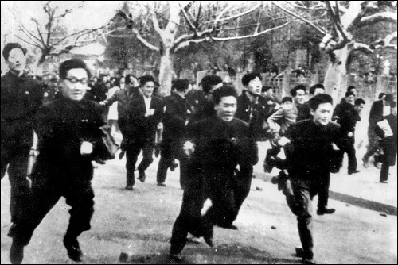
Seoul National University
On April 19, tens of thousands of students took to the streets of Seoul. At the presidential palace, the palace guards opened fire, killing at least 20 people in the first volley. Remarkably, students fought back. Small action teams destroyed the headquarters building of Rhee’s Liberal Party as well as that of the Anticommunist Youth League, the editorial offices of the government newspaper, and five police substations

Slide 7
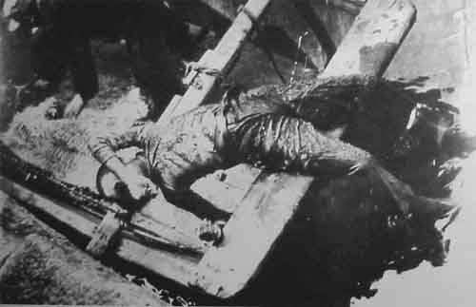
Before the violence ended, gunfire on “Bloody Tuesday” had claimed dozens of lives. In Seoul alone, more than one hundred people were killed and over 1000 wounded. Ultimately, martial law was declared, the army was called out, and a 10 p.m. curfew strictly enforced, but the army did not open fire. General Song Yo-chan ordered his troops not to shoot. “We are brothers!” soldiers and students reportedly shouted to each other.

Slide 8
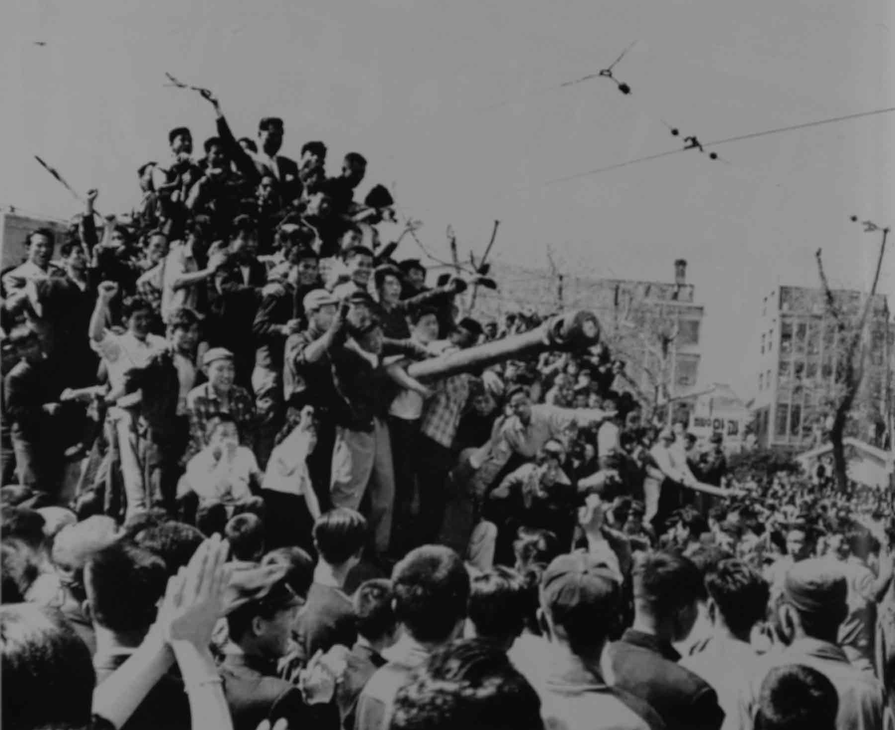
-
On April 26, Rhee resigned and left Korea. When the dead were identified and totaled, they numbered 186. At least 46 of those people were high school students (7th to 12th grades), and the vast majority of those killed were less than 30 years old. An additional 6000 people had been injured.

Slide 9
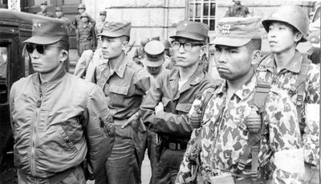
Military Coup
Park Chung-hee 1961-1979

Slide 10
BuMa Uprising 1979
August 11 Police arrest 170 workers during YH Company labor strike; worker Kim Kyung-suk is killed.
October 4 Kim Young-sam expelled from National Assembly
October 16 Pusan University students march downtown; Army called out: 50,000 protest; 400 arrests, 600 injured; 11 police boxes destroyed.
October 18 Martial Law declared in Busan; Masan protests break out: 10,000+ in streets as workers join.
October 20 Martial Law declared in Masan
October 26 Park Chun-hee assassinated by his own KCIA chief
December 12 Chun Doo-Hwan military coup

Slide 11
The protests’ sudden popularity surprised everyone—especially the students who initiated them.
On October 15, Lee Chin-gol wrote an anonymous anti-Yushin leaflet. Unbeknownst to him, Chung Kwan-min also produced a similar hand-printed leaflet.
The next morning, Chung rose from his seat in an economics seminar and called on his fellow students to join him: “Classmates, let’s go out and fight for democracy!”

Slide 12
Numbers Grew Quickly
As Chung strode out the door, a few students followed him, and they all shouted for others to come along.
By the time they reached front of the library, 100 students had joined. They sang the national anthem and minjung songs, and within a few minutes, 200 or more students were gathered. Chung rose and read his leaflet verbatim. Conservative professors and undercover police tried to stop them, but people moved to another part of campus. A long line of students was in motion.
As the group passed a building—any building at that explosive moment—their ranks swelled. Within an hour, there were 1,000, then 2,000. When riot police invaded the campus, students fought back. Finally about 4,000 students gathered, out of a student body of less than 10,000.

Slide 13
Going Downtown
Students pushed through police lines and headed downtown—nearly 10 miles away.
Some took buses, while the majority kept together and marched.
As they proceeded to walk downtown, citizens they encountered applauded and plied them with soft drinks, snacks, and money.
Thousands more people swelled their ranks, and the local populace protected them.

Slide 14
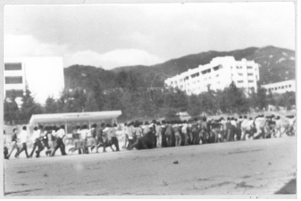
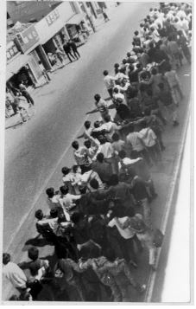
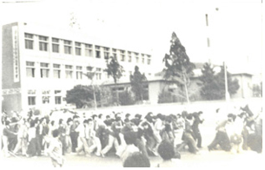
온천장으로 나오는 부산대 학생들
Pusan University students

Slide 15
Nampodong
At 3 p.m., the procession reached downtown Nampodong (site of the 1960 protests that began the uprising to overthrow Syngman Rhee).
At least 30,000 people gathered. The police divided the crowd into small groups, but by 5 p.m. people were able to regroup as the national anthem was played and the flag was lowered.
“Normally we students disliked the Korean national anthem, but that day we sang it with gusto,” explained Kim Jong-ho.
As soon as the ritual concluded, people surged ahead, but riot police attacked.

Slide 16
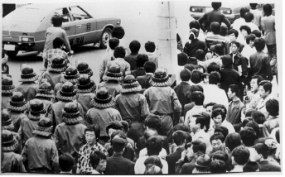
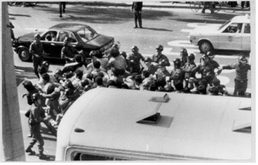
Demonstrators being stopped by police
지나가는 데모 대열 막는 기동대(동래경찰서 정보과 사진 입수)

Slide 17
People overturned police cars, and the crowd commanded the streets until dawn.
“All over the city, small groups huddled together, traded information, planned, dreamed, and for the first time in years, spoke openly about their dreams.”
Prostitutes applauded them, as did people in hotels, giving the youth a feeling of being the heroes of a “ticket-tape parade” as they shouted, “Destroy Yushin!”; “End the Dictatorship!”; and “Reinstate Kim Young Sam!”
Shopkeepers shared apples and bread.

Slide 18
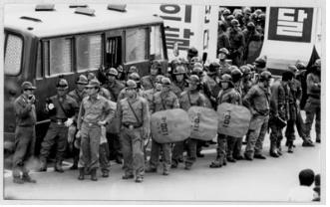
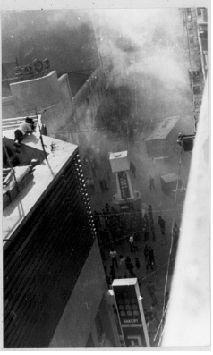
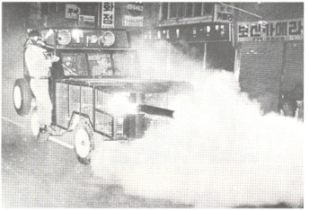

Slide 19
Citizens Join the Protests
The poor and lumpen joined the street actions, and at one point, they led people to the tax office and set it on fire.
More than a dozen police vans were attacked. Despite a midnight curfew and the presence of the army, many students stayed downtown.
By 1 a.m. 11 police boxes had been destroyed. When dawn rose, 400 people had been arrested and 600 wounded.

Slide 20
October 17
At 10 a.m. the next day, Donga University students organized a new protest. Close to downtown, they led a peaceful assembly from their campus to the downtown area.
Once again, local people overwhelmingly supported the students, giving them money, food and water. Sustained by their supporters, the protesters continued into the night.
More militant members of the group set upon buildings symbolizing Park’s ruled and set them to the torch. By 9 p.m., two television stations (KBS and MBC), a district revenue office, 21 police substations, and other government offices had been destroyed.

Slide 21
October 18: Martial Law
Altogether in the two days of protests, 1,058 arrests and probably an equal number of wounded.
US embassy reports claimed 12,000 people had attacked two television stations and repeated the main newspaper’s figures of 800 arrests and 79 police injured.
By the early morning hours of October 18, martial law had been declared and army units were in position around City Hall and broadcast stations. Classes were cancelled at all major universities. As one activist related, “Anyone who looked like a student was arrested and beaten, so we all went home.” A small demonstration was easily broken up.

Slide 22
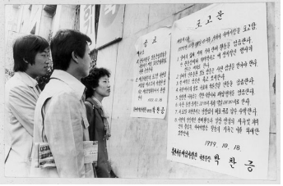
Martial Law Declared
계엄령을 발표한 포고문을 읽는 시민들

Slide 23
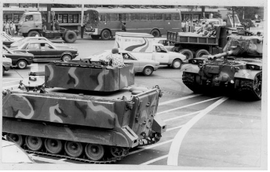
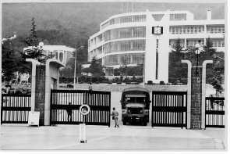
Martial Law

Slide 24
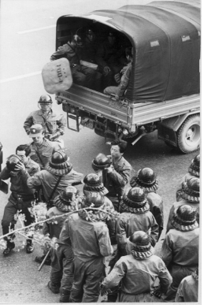
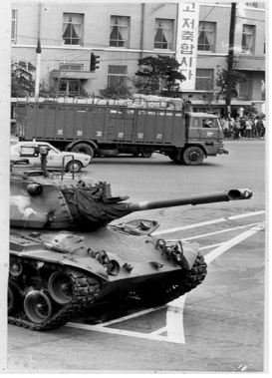
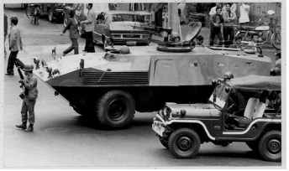

Slide 25
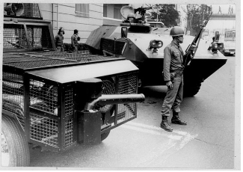
Busan:Old City Hall
계엄령이 떨어진 새벽 구 시청 앞.
가스차와 장갑차 그리고 경비를 서고 있는 군인

Slide 26
Masan October 18
Pusan may have been pacified, but the protests spread to neighboring Masan, where once again student demonstrators drew widespread support.
Assembling at Masan’s April 19 memorial, over 1000 students from Kyongnam University marched downtown around 5 p.m. and fought their way to the ruling Democratic Republican Party headquarters.
With support from many working class citizens, thousands of people attacked Park Chung-hee’s party office and 18 other public buildings. The government quickly extended martial law to Masan, and the army arrested 238 citizens. To keep the city quiet, 1,500 armed soldiers patrolled the streets.

Slide 27
Masan
Workers from Masan Export Processing Zone and high school students joined the protests.
Martial Law was declared in Changwon and Masan on October 20

Slide 28
October 16-19: Four Days That Changed Korea
In four days of the Puma uprising, at least 1,563 arrests were made, around a third of whom were students.
While only a four-day event, the Puma uprising was a life-altering experience for many young people who tasted the freedom of the streets for the first time. That struggle generated men and women who went to lead movements in the future.
  Although the protests occurred in October, Bruce Cumings curiously states they occurred in August and September of 1979. Cumings, Civil Society in West and East, in Charles Armstrong, (editor), Korean Society: Civil Society, Democracy and the State (London: Routledge, 2002) p. 23.

Slide 29
Park Kae-dong, went on to become elected members of the National Assembly.
Another activist, Noh Moo Hyun, went on to become president of the country.
Writer Kim Ha-gi went onto a life of activism. As he told me, Puma was the turning point in his life. For him, it was “like the French Revolution, where the people supported the movement. We had always been disappointed before, but this time, the civil revolution really happened. It was as if the dead returned to help the living.”
Chung Kwan-min was also sent on a trajectory of years of activism by his Puma experiences. After helping run a social science bookstore for years, he became a labor activist.

Slide 30
Park Chung-hee Killed
The main outcome of Puma was the assassination on October 26 of Park Chung-hee by his own chief of intelligence, Kim Jae-kyu.
While sadness and shock were the media reactions, many people celebrated.
Thousands of political prisoners were released, suspended student governments were reinstated, and 793 students expelled for Puma activities, in the words of an official US document, “returned to campus as heroes.”

Slide 31
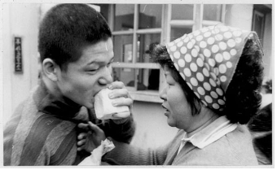
특사 출소자들에게 두부를 먹이는 가족
Coming out of jail--eating tofu

Slide 32
Chun’s 12-12 Coup and the Seoul Spring
Amid the swirl of events unleashed by the end of the dictatorship, a tiny coterie of 38 army officers under the leadership of Chun Doo Hwan and Roh Tae-woo seized control of the military on December 12, 1979.
They arrested dozens of high ROK officers and killed servicemen guarding the ROK headquarters building.

Slide 33
US Involvement
On May 9, US ambassador William Gleysteen met with Chun in the very same “safe house” where Park had been killed.
In preparation for the meeting, he promised Washington that he would not “in any way suggest that the US government opposes Korean government contingency plans to maintain law and order, if absolutely necessary by reinforcing the police with the army.”
True to his word, Gleysteen reminded Chun that “the government had to be ready to maintain law and order.”

Slide 34
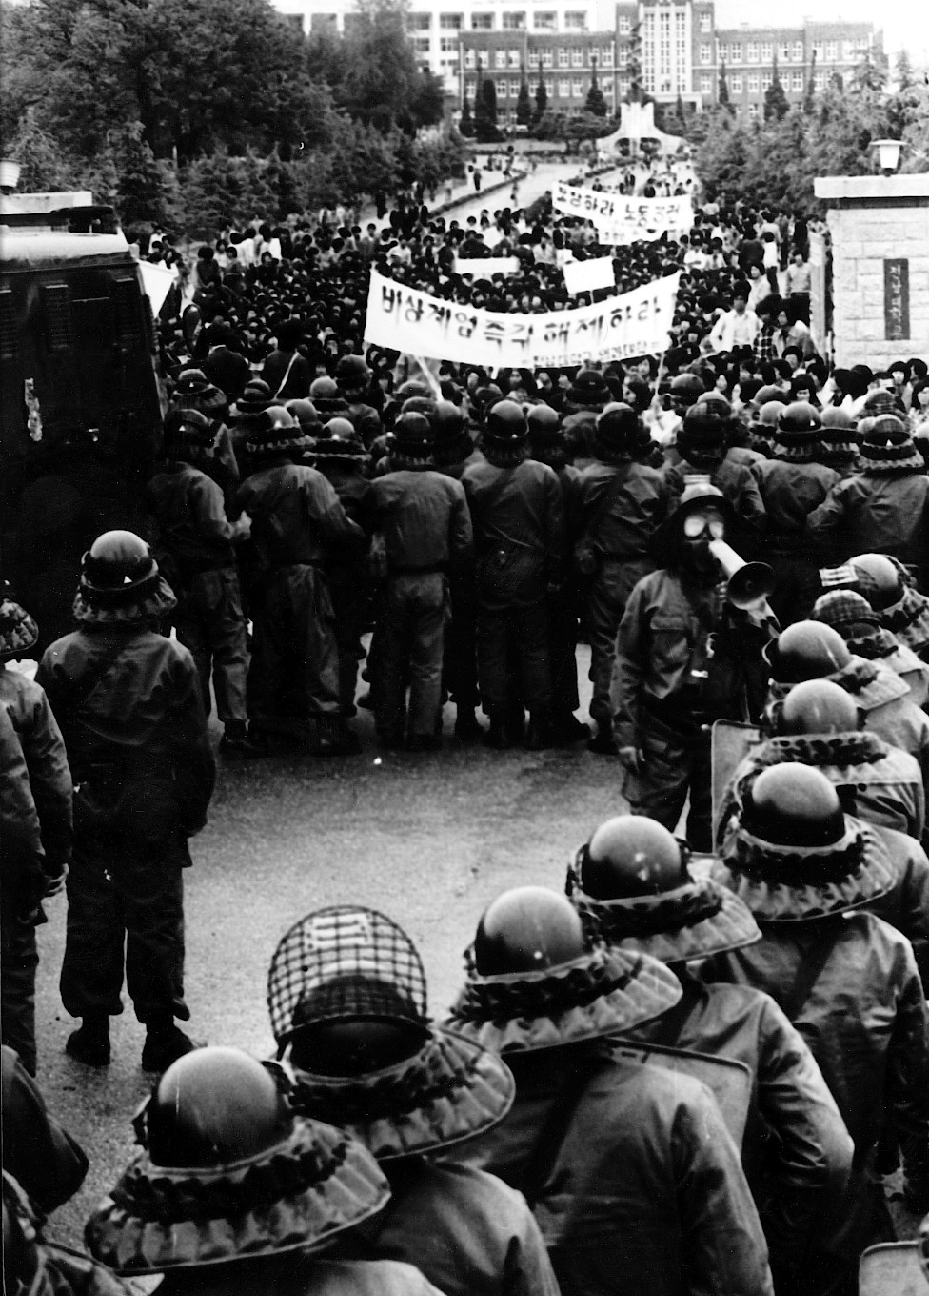
Gwangju: May 18, 1980
Students Broke Through Police Lines at Chonnam National University and Sparked the May 18 Uprising

